Slide 1
OWL-M: A MATERIAL DESIGN STUDY APP
Charulatha. A
710422104008

Slide 2
DESCRIPTION
Owl-M: Owl-M is an educational app designed to help users understand and explore the principles of Google's Material Design. It serves as a comprehensive study tool for developers and designers aiming to implement Material Design in their projects.
Material Design Principles: The app demonstrates key principles of Material Design, including responsive layouts, dynamic transitions, bold typography, and the effective use of color, shadows, and hierarchy.
Interactive Learning: Users can engage with interactive lessons and examples that showcase how Material Design components like Floating Action Buttons (FAB), Cards, and Bottom Navigation Bars are implemented.
Customizable Themes: Owl-M features options for light and dark themes, helping users see the impact of Material Design in different visual settings and environments.
Design Guidelines: The app offers detailed explanations of Material Design guidelines, including tips for consistency, accessibility, and creating intuitive user interfaces.
Developer Tools: Owl-M integrates developer-focused tools and resources, such as code snippets, design blueprints, and downloadable assets, to simplify the implementation process.
Quizzes and Challenges: To enhance learning, the app includes quizzes and challenges that test the user's knowledge of Material Design concepts and practices.
Modern User Interface: With a clean, minimalistic UI built on Material Design itself, Owl-M provides a hands-on learning experience while serving as a living example of its principles.

Slide 3
LoginActivity.kt:
package com.example.owlapplication
import android.content.Context
import android.content.Intent
import android.os.Bundle
import androidx.activity.ComponentActivity
import androidx.activity.compose.setContent
import androidx.compose.foundation.Image
import androidx.compose.foundation.background
import androidx.compose.foundation.layout.*
import androidx.compose.material.*
import androidx.compose.runtime.*
import androidx.compose.ui.Alignment
import androidx.compose.ui.Modifier
import androidx.compose.ui.graphics.Color
import androidx.compose.ui.layout.ContentScale
import androidx.compose.ui.res.painterResource
import androidx.compose.ui.text.font.FontFamily
import androidx.compose.ui.text.font.FontWeight
import androidx.compose.ui.text.input.PasswordVisualTransformation

Slide 4
import androidx.compose.ui.tooling.preview.Preview
import androidx.compose.ui.unit.dp
import androidx.compose.ui.unit.sp
import androidx.core.content.ContextCompat
import com.example.owlapplication.ui.theme.OwlApplicationTheme
class LoginActivity : ComponentActivity() {
private lateinit var databaseHelper: UserDatabaseHelper
override fun onCreate(savedInstanceState: Bundle?) {
super.onCreate(savedInstanceState)
databaseHelper = UserDatabaseHelper(this)
setContent {
LoginScreen(this, databaseHelper)
}
}
}
@Composable
fun LoginScreen(context: Context, databaseHelper: UserDatabaseHelper) {
var username by remember { mutableStateOf("") }
var password by remember { mutableStateOf("") }
var error by remember { mutableStateOf("") }

Slide 5
Column(
modifier = Modifier.fillMaxSize().background(Color.White),
horizontalAlignment = Alignment.CenterHorizontally,
verticalArrangement = Arrangement.Center
) {
Image(painterResource(id = R.drawable.study_login), contentDescription = "")
Text(
fontSize = 36.sp,
fontWeight = FontWeight.ExtraBold,
fontFamily = FontFamily.Cursive,
text = "Login"
)
Spacer(modifier = Modifier.height(10.dp))
TextField(
value = username,
onValueChange = { username = it },
label = { Text("Username") },
modifier = Modifier.padding(10.dp)
.width(280.dp)

Slide 6
)
TextField(
value = password,
onValueChange = { password = it },
label = { Text("Password") },
visualTransformation = PasswordVisualTransformation(),
modifier = Modifier.padding(10.dp)
.width(280.dp)
)
if (error.isNotEmpty()) {
Text(
text = error,
color = MaterialTheme.colors.error,
modifier = Modifier.padding(vertical = 16.dp)
)
}
Button(
onClick = {

Slide 7
if (username.isNotEmpty() && password.isNotEmpty()) {
val user = databaseHelper.getUserByUsername(username)
if (user != null && user.password == password) {
error = "Successfully log in"
context.startActivity(
Intent(
context,
MainActivity::class.java
)
)
//onLoginSuccess()
}
else {
error = "Invalid username or password"
}
} else {
error = "Please fill all fields"
}
},
modifier = Modifier.padding(top = 16.dp)

Slide 8
) {
Text(text = "Login")
}
Row {
TextButton(onClick = {context.startActivity(
Intent(
context,
RegisterActivity::class.java
)
)}
)
{ Text(text = "Register") }
TextButton(onClick = {
})
{
Spacer(modifier = Modifier.width(60.dp))
Text(text = "Forget password?")
}
}
}
}

Slide 9
private fun startMainPage(context: Context) {
val intent = Intent(context, MainActivity::class.java)
ContextCompat.startActivity(context, intent, null)
}
RegisterActivity.kt:
package com.example.owlapplication
import android.content.Context
import android.content.Intent
import android.os.Bundle
import androidx.activity.ComponentActivity
import androidx.activity.compose.setContent
import androidx.compose.foundation.Image
import androidx.compose.foundation.background
import androidx.compose.foundation.layout.*
import androidx.compose.material.*
import androidx.compose.runtime.*
import androidx.compose.ui.Alignment
import androidx.compose.ui.Modifier
import androidx.compose.ui.graphics.Color

Slide 10
import androidx.compose.ui.layout.ContentScale
import androidx.compose.ui.res.painterResource
import androidx.compose.ui.text.font.FontFamily
import androidx.compose.ui.text.font.FontWeight
import androidx.compose.ui.text.input.PasswordVisualTransformation
import androidx.compose.ui.tooling.preview.Preview
import androidx.compose.ui.unit.dp
import androidx.compose.ui.unit.sp
import androidx.core.content.ContextCompat
import com.example.owlapplication.ui.theme.OwlApplicationTheme
class RegisterActivity : ComponentActivity() {
private lateinit var databaseHelper: UserDatabaseHelper
override fun onCreate(savedInstanceState: Bundle?) {
super.onCreate(savedInstanceState)
databaseHelper = UserDatabaseHelper(this)
setContent {
RegistrationScreen(this, databaseHelper)
}
}
}

Slide 11
@Composable
fun RegistrationScreen(context: Context, databaseHelper: UserDatabaseHelper) {
var username by remember { mutableStateOf("") }
var password by remember { mutableStateOf("") }
var email by remember { mutableStateOf("") }
var error by remember { mutableStateOf("") }
Column(
modifier = Modifier.fillMaxSize().background(Color.White),
horizontalAlignment = Alignment.CenterHorizontally,
verticalArrangement = Arrangement.Center
) {
Image(painterResource(id = R.drawable.study_signup), contentDescription = "")
Text(
fontSize = 36.sp,
fontWeight = FontWeight.ExtraBold,
fontFamily = FontFamily.Cursive,
text = "Register"
)

Slide 12
Spacer(modifier = Modifier.height(10.dp))
TextField(
value = username,
onValueChange = { username = it },
label = { Text("Username") },
modifier = Modifier
.padding(10.dp)
.width(280.dp)
)
TextField(
value = email,
onValueChange = { email = it },
label = { Text("Email") },
modifier = Modifier
.padding(10.dp)
.width(280.dp)
)
TextField(
value = password,

Slide 13
onValueChange = { password = it },
label = { Text("Password") },
visualTransformation = PasswordVisualTransformation(),
modifier = Modifier
.padding(10.dp)
.width(280.dp)
)
if (error.isNotEmpty()) {
Text(
text = error,
color = MaterialTheme.colors.error,
modifier = Modifier.padding(vertical = 16.dp)
)
}
Button(
onClick = {
if (username.isNotEmpty() && password.isNotEmpty() && email.isNotEmpty()) {
val user = User(

Slide 14
id = null,
firstName = username,
lastName = null,
email = email,
password = password
)
databaseHelper.insertUser(user)
error = "User registered successfully"
// Start LoginActivity using the current context
context.startActivity(
Intent(
context,
LoginActivity::class.java
)
)
} else {
error = "Please fill all fields"
}
},
modifier = Modifier.padding(top = 16.dp)

Slide 15
) {
Text(text = "Register")
}
Spacer(modifier = Modifier.width(10.dp))
Spacer(modifier = Modifier.height(10.dp))
Row() {
Text(
modifier = Modifier.padding(top = 14.dp), text = "Have an account?"
)
TextButton(onClick = {
context.startActivity(
Intent(
context,
LoginActivity::class.java
)
)
})
{
Spacer(modifier = Modifier.width(10.dp))
Text(text = "Log in")

Slide 16
}
}
}
}
private fun startLoginActivity(context: Context) {
val intent = Intent(context, LoginActivity::class.java)
ContextCompat.startActivity(context, intent, null)
}

Slide 17
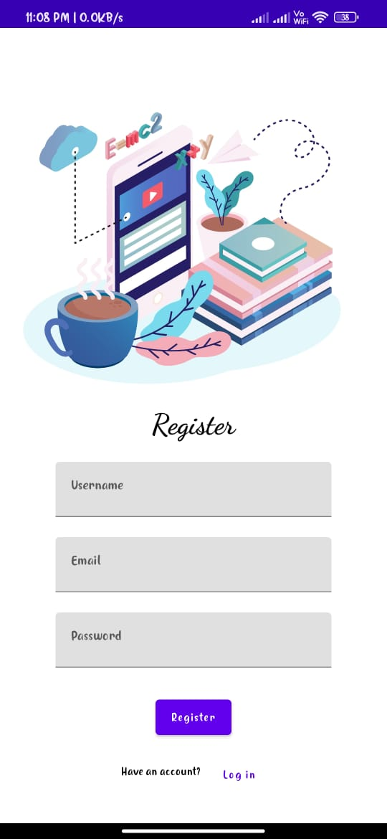
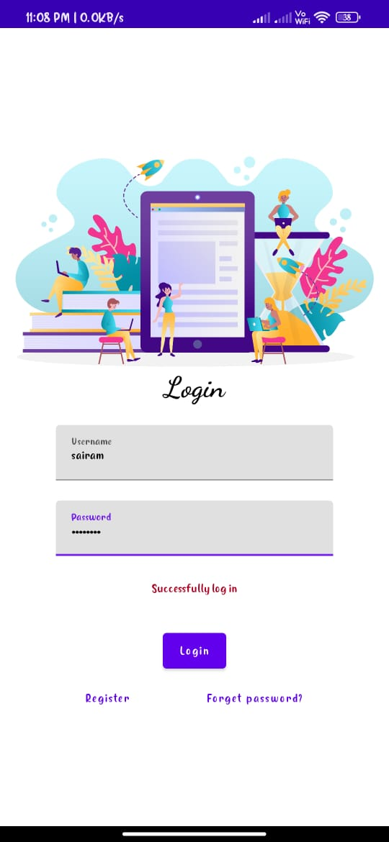
OUTPUT:

Slide 18
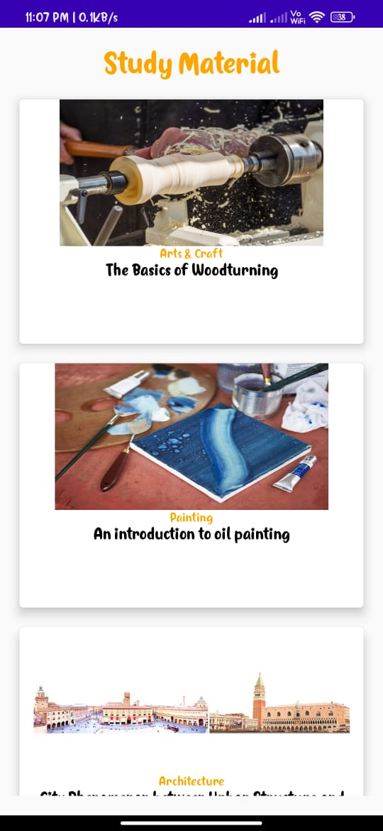
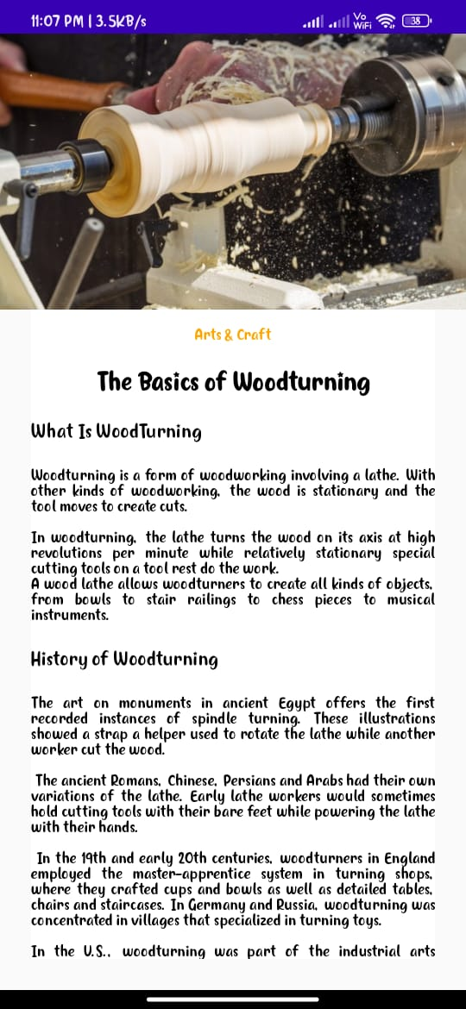

Slide 19
